Slide 1
operators
Gradient, divergence, curl problem solving

Slide 2
Gradient
The gradient of any line or curve tells us the rate of change of one variable with respect to another. This is a vital concept in all mathematical sciences.
Gradient is a measure of how steep a slope is. The greater the gradient the steeper a slope is.
Gradient, in mathematics, a differential operator applied to a three-dimensional vector-valued function to yield a vector whose three components are the partial derivatives of the function with respect to its three variables. The symbol for gradient is ∇.

Slide 3
Scalar and vector field
FIELD is a description of how a physical quantity varies from one point to another in the region of the field (and with time).
(a) Scalar fields
Ex: Depth of a lake, d(x, y)
Temperature in a room, T(x, y, z)
A scalar field is an assignment of a scalar to each point in region in the space. E.g. the temperature at a point on the earth is a scalar field. A vector field is an assignment of a vector to each point in a region in the space.

Slide 4
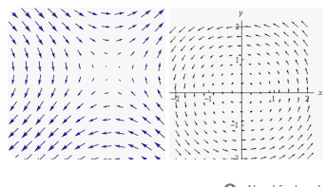
Vector field
In vector calculus and physics, a vector field is an assignment of a vector to each point in a subset of space. For instance, a vector field in the plane can be visualised as a collection of arrows with a given magnitude and direction, each attached to a point in the plane.

Slide 5
A field is a quantity which can be specified everywhere in space as a function of position.
The quantity that is specified may be a scalar or a vector.
For instance, we can specify the temperature at every point in a room.
The room may, therefore, be said to be a region of “temperature field” which is a scalar field because the temperature T (x, y, z) is a scalar function of the position.
An example of a scalar field in electromagnetism is the electric potential.

Slide 6
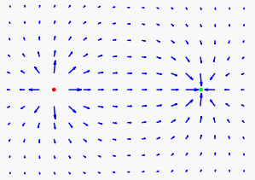
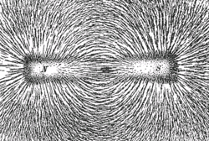
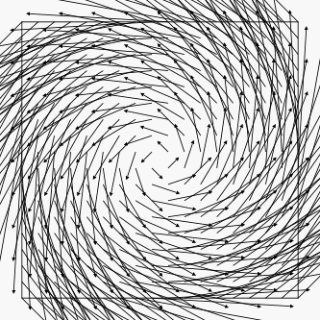
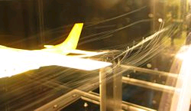
Physical examples of vector fields:
+
−
Electric field surrounding a positive and a negative charge.
Magnetic field lines shown by iron filings
The flow field around an airplane
Hurricane

Slide 7
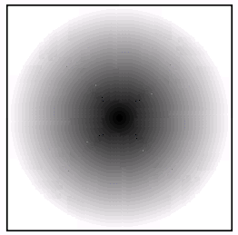
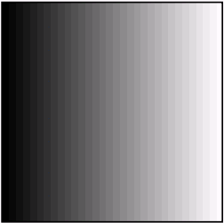
Physical examples of scalar fields:
+
Electric potential around a charge
Temperature near a heated wall
(The darker region representing higher values )

Slide 8
Gradient of scalar field
The gradient of a certain scalar field is the vector representing the direction and the magnitude of the maximal rate change and increase (in space) of that scalar field .

Slide 9
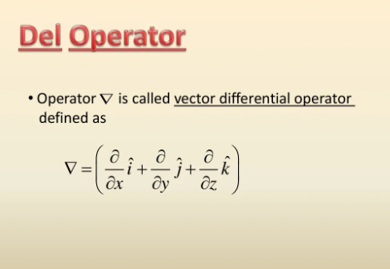

Slide 10
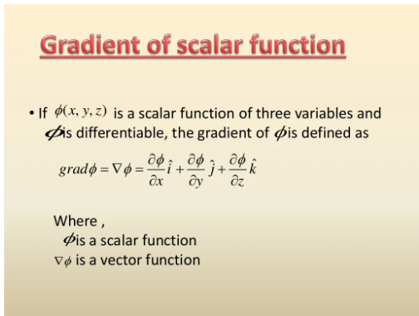

Slide 11
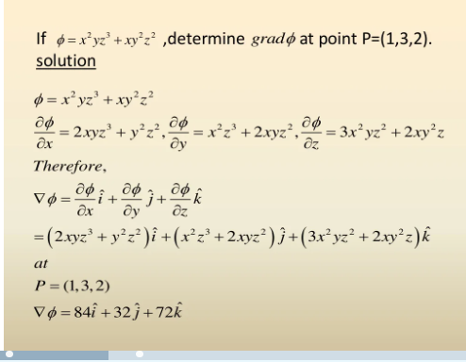

Slide 12
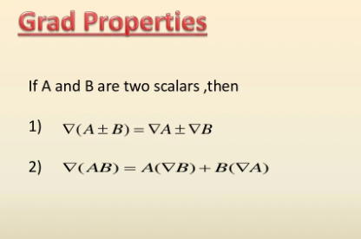

Slide 13
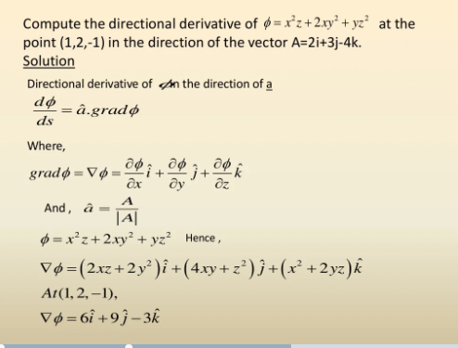

Slide 14
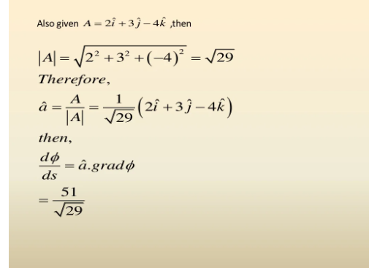

Slide 15
Example 1
If φ(x,y,z) = 3x²y– y²z², find grad φ and at the point (1,2,−1).

Slide 16
Solution
At the point (1,2,−1),

Slide 17
Divergence
Roughly speaking, divergence measures the tendency of the fluid to collect or disperse at a point
The divergence of a vector field measures the density of change in the strength of the vector field. In other words, the divergence measures the instantaneous rate of change in the strength of the vector field along the direction of flow.

Slide 18
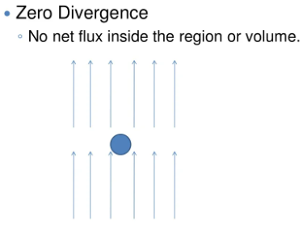
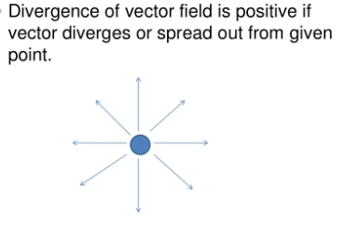
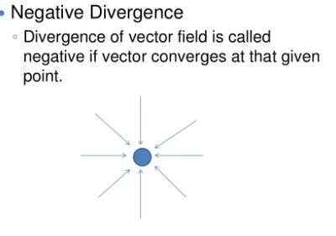
Divergence
Physically divergence means that either the fluid is expanding or that fluid is being supplied by a source external to the field. The lines of flow diverge from a source and converge to a sink. If there is no gain or loss of fluid anywhere t
hen div F = 0.

Slide 19
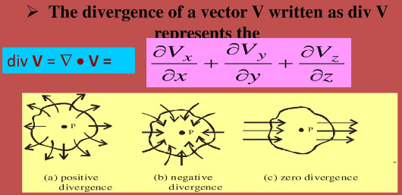
Divergence

Slide 20
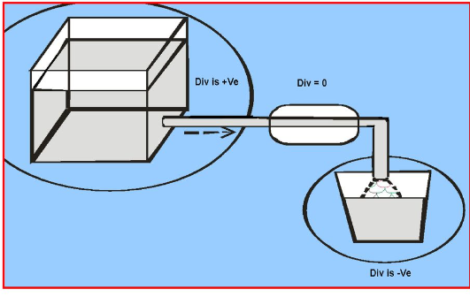

Slide 21
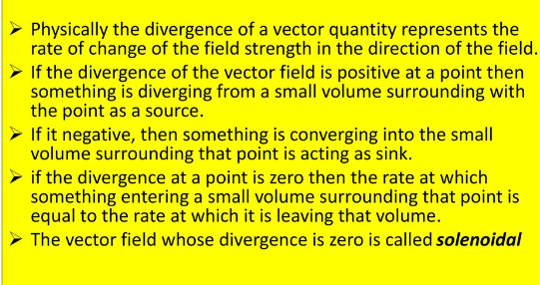

Slide 22
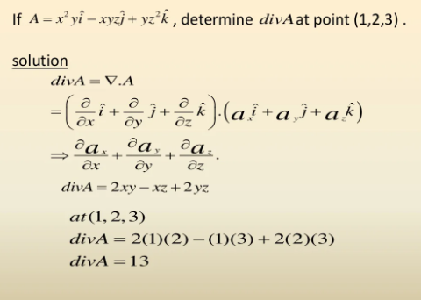

Slide 23
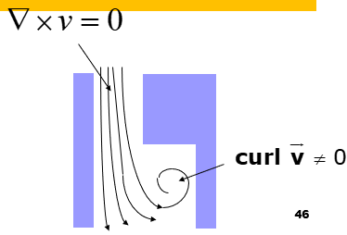
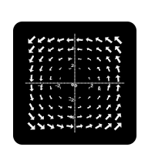
Curl
The curl of a vector field measures the tendency for the vector field to swirl around. Imagine that the vector field represents the velocity vectors of water in a lake. If the vector field swirls around, then when we stick a paddle wheel into the water, it will tend to spin.

Slide 24
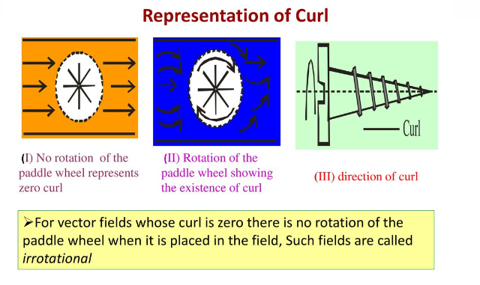

Slide 25
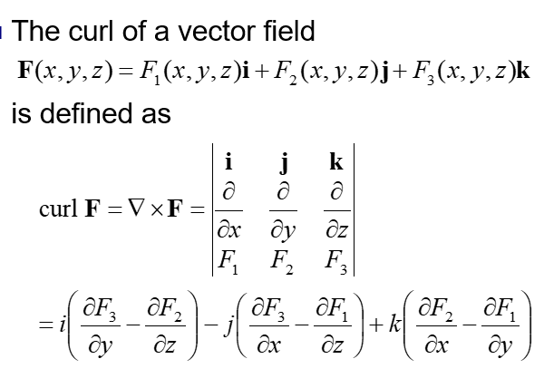
Curl of a vector field

Slide 26


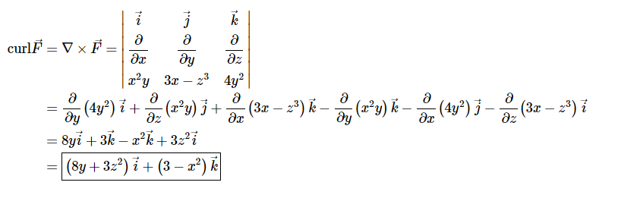
Practice problems, Compute divergence and curl
1.

Slide 27

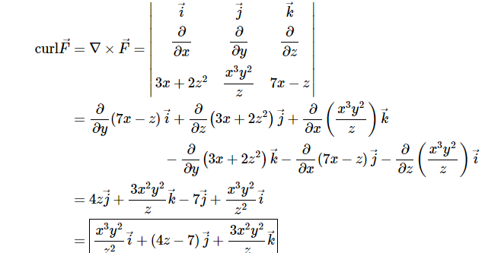
Problem 2. compute div and curl

Slide 28

Thank you

